Slide 1
Category Review: Chips
Ed Garcia

Slide 2
Executive Summary
Customer Trends & Target Segment, Jul ’18 - Jun ’19
Highest daily chips sales: week before Christmas
Best-sellers: Kettle, Smith’s, Pringles, Doritos. Christmas uptick: Thins, Twisties
Recommended promos on 200g+ pack sizes
Target segment: Young singles/couples (mainstream affluence). Recommend off-locate their preferred products
Trial Store Layout Analysis, Feb-Mar 2019
Store 77: Significant increase in sales and # of customers, especially March, April
Store 86: Significant increase in # of customers, but sales not significantly higher
Store 88: Significant increase in sales, but # of customers not significantly higher

Slide 3
Customer Trends & Target Segment, Jul ’18 - Jun ’19

Slide 4
Christmas sales peak (Dec 18 - 24, 2018)
A strong focus should be allotted to the Christmas season in terms of stock quantity of specific brands and pack sizes.

Slide 5
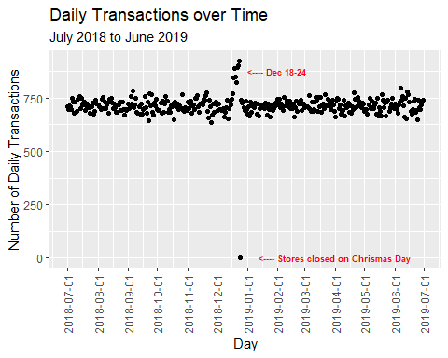
Daily chip transactions increased 22% during Christmas

Slide 6
Sales by brand and Christmas brand recommendation
Kettle products sell the most, followed by Smith’s, Pringles, and Doritos.
Christmas uptick: Thins and Twisties showed noticeable improvement and should be strategically located to boost sales.

Slide 7
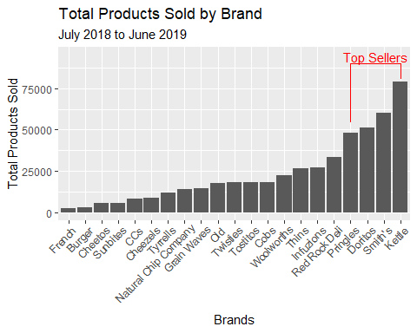
Best-sellers: Kettle (80k), Smith’s (60k), Pringles (50k), Doritos (50k)

Slide 8
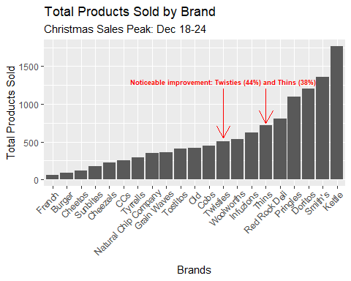
Year-long best-sellers top the Christmas list

Slide 9
Christmas pack size stock recommendation
Most popular pack sizes (year-round + Christmas): 150-200g
Christmas customers prefer 175g pack sizes, followed by 150g.
Christmas customers did not prefer 200g+ pack sizes, but promos could increase Christmas sales.

Slide 10
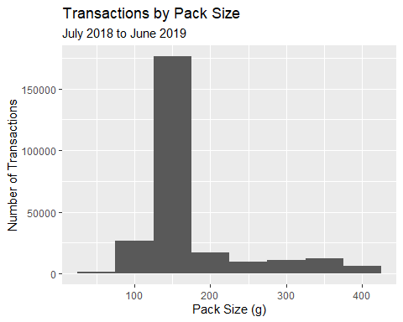
Most popular pack sizes: 150-200g

Slide 11
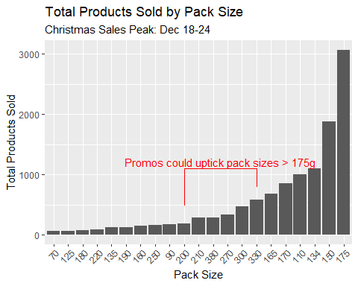
Christmas customers prefer 175g pack sizes, followed by 150g

Slide 12
Summary of Customer Segments
Top sales: Older Families (Budget), Young Singles/Couples & Retirees (Mainstream)
Top # of customers: Young Singles/Couples & Retirees (Mainstream)
Top units per customer: Older Families, Young Families
Highest average unit price: Young & Midage Singles/Couples (Mainstream)

Slide 13
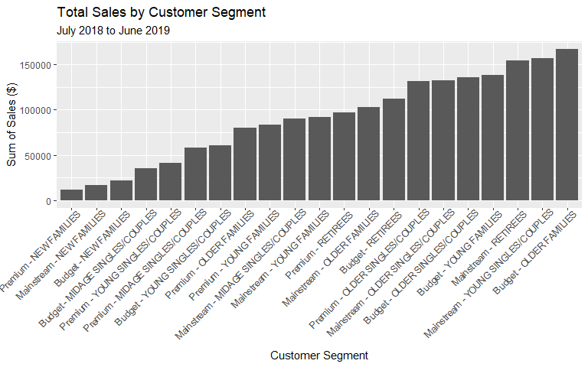
Top sales: Older Families (Budget), Young Singles/Couples & Retirees (Mainstream)

Slide 14
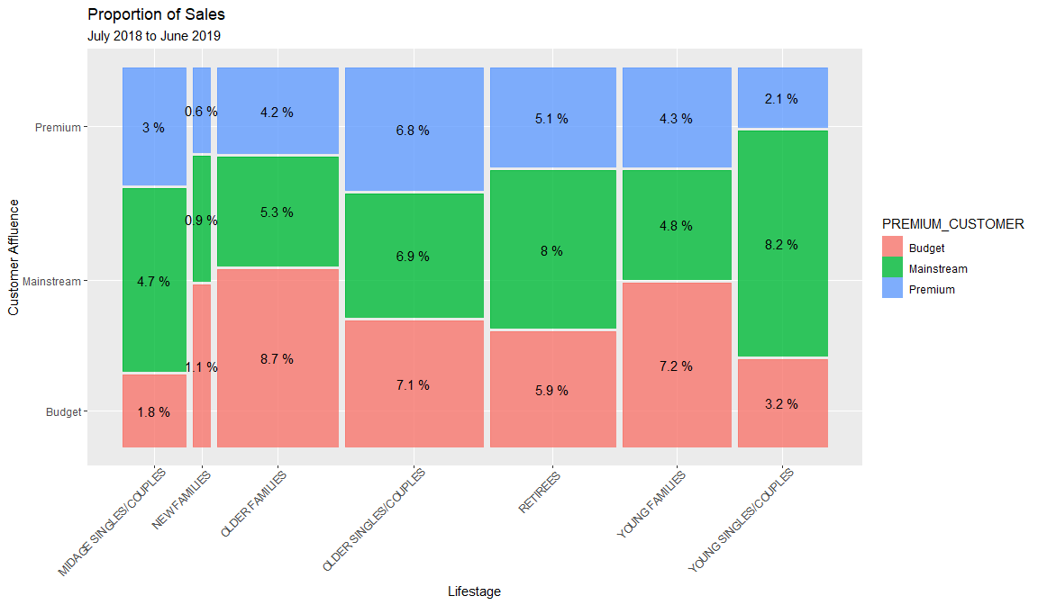
Young Singles/Couples (Mainstream): 8.2% of all sales

Slide 15
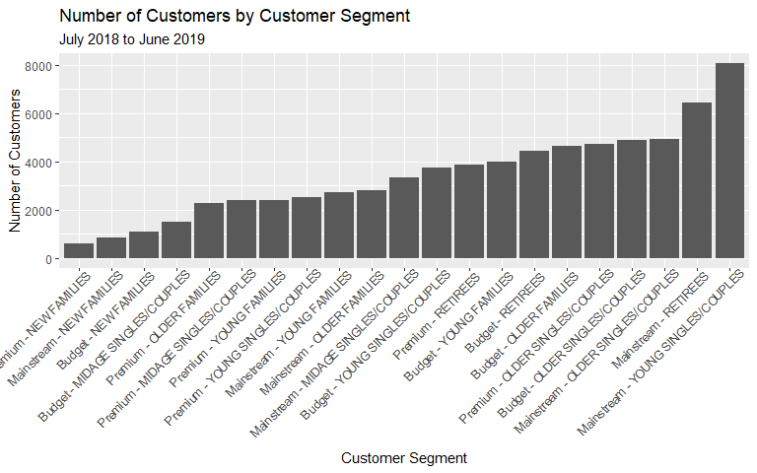
Top number of customers: Young Singles/Couples & Retirees (Mainstream)

Slide 16
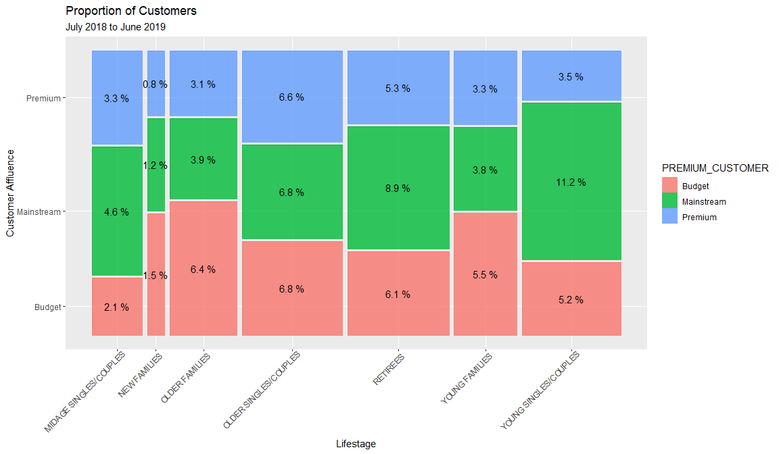
Young Singles/Couples: 11.2% of all customers

Slide 17
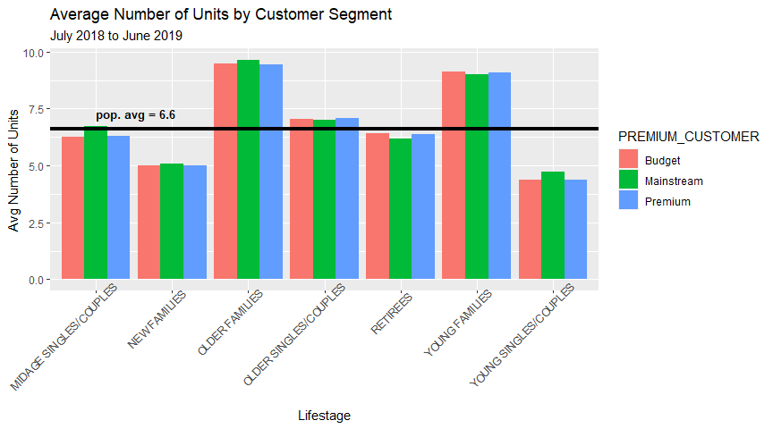
Top units per customer: Older Families, Young Families

Slide 18
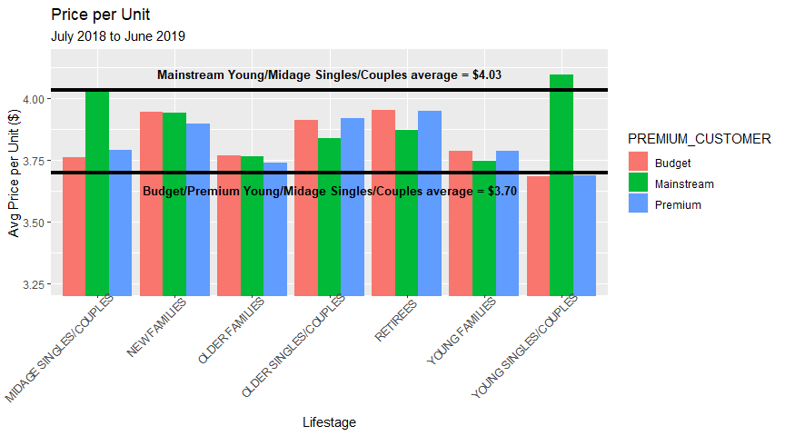
Highest average unit price: Young & Midage Singles/Couples (Mainstream)

Slide 19
Young Singles/Couples (Mainstream):
23% more likely to buy Tyrrells, 22% for Twisties
56% less likely to buy Burger Rings chips
27% more likely to buy 270g packs of chips (only Twisties has these)
Tyrells and Twisties can be off-located to other popular store parts that this segment shops in
270g Twisties could be marketed to this segment during Christmas

Slide 20
Trial Store Layout Analysis, Feb-March 2019

Slide 21
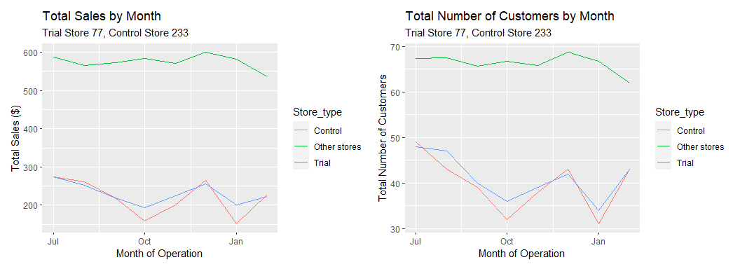
Best match: trial store 77 closely matches store 233 in sales and number of customers during pre-trial period

Slide 22
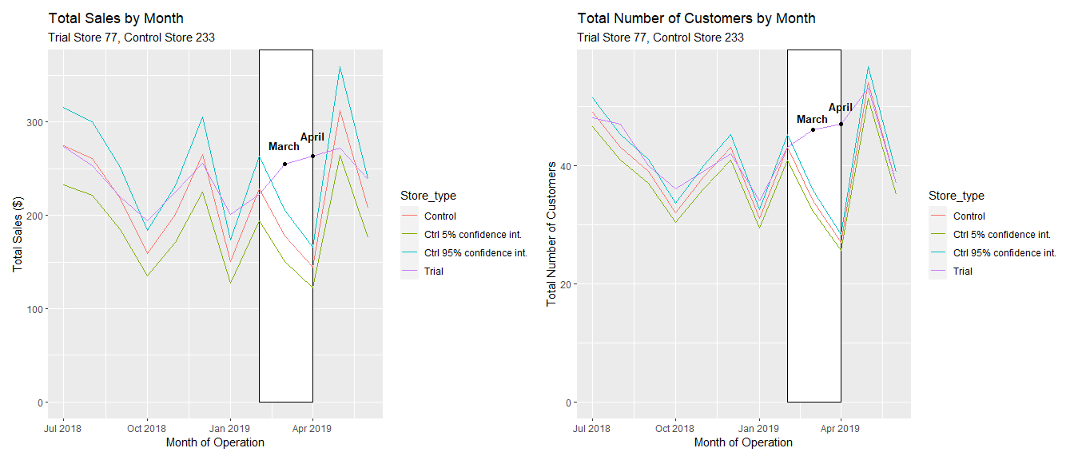
Store 77: Significant increase in sales and number of customers, especially March, April

Slide 23
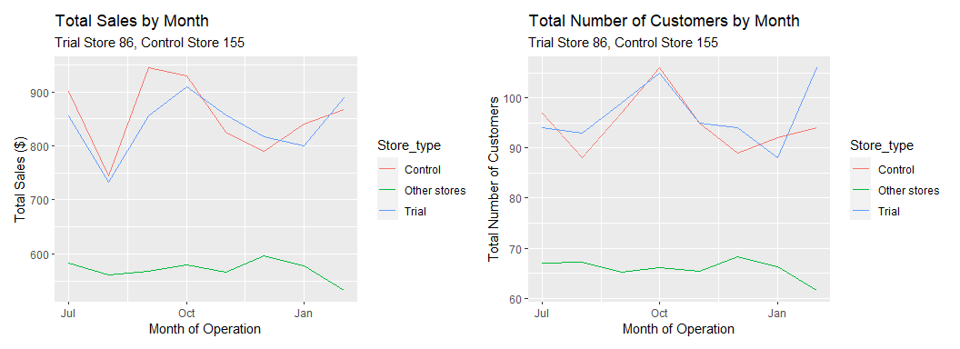
Best match: trial store 86 closely matches store 155 in sales and number of customers during pre-trial period

Slide 24
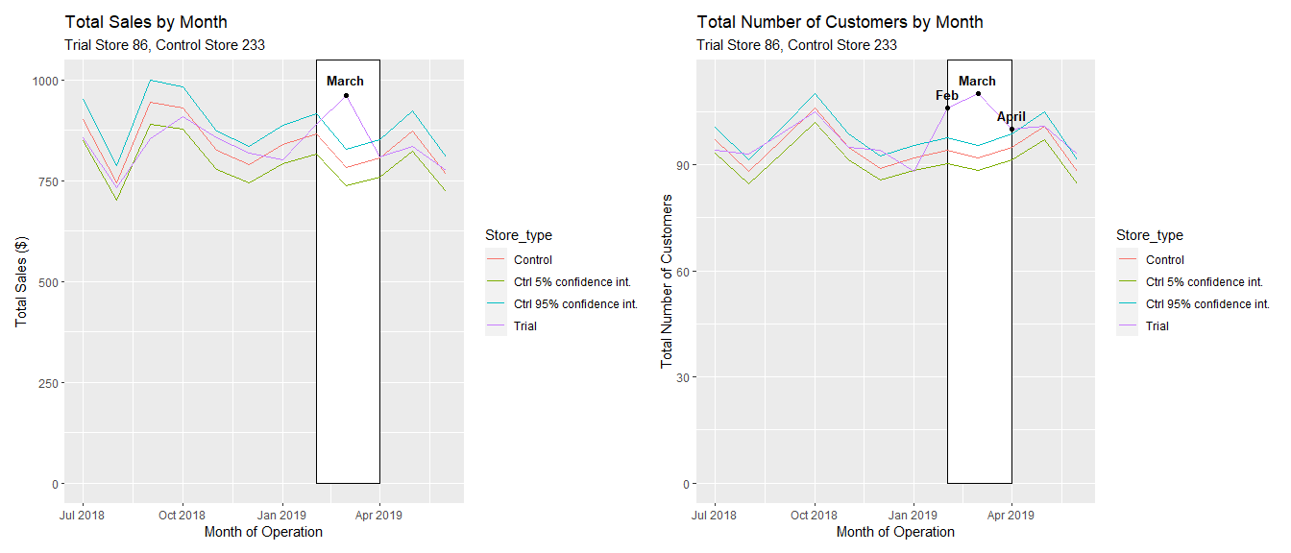
Store 86: Significant increase in number of customers all 3 months, but sales not significantly higher

Slide 25
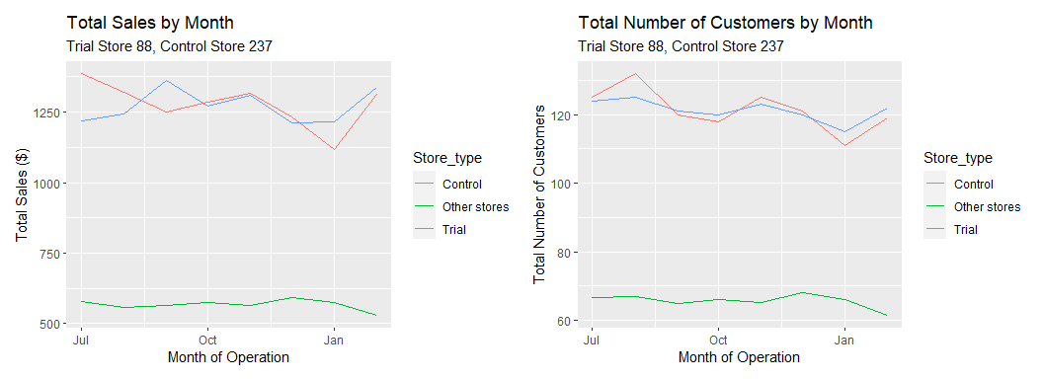
Best match: trial store 88 closely matches store 237 in sales and number of customers during pre-trial period

Slide 26
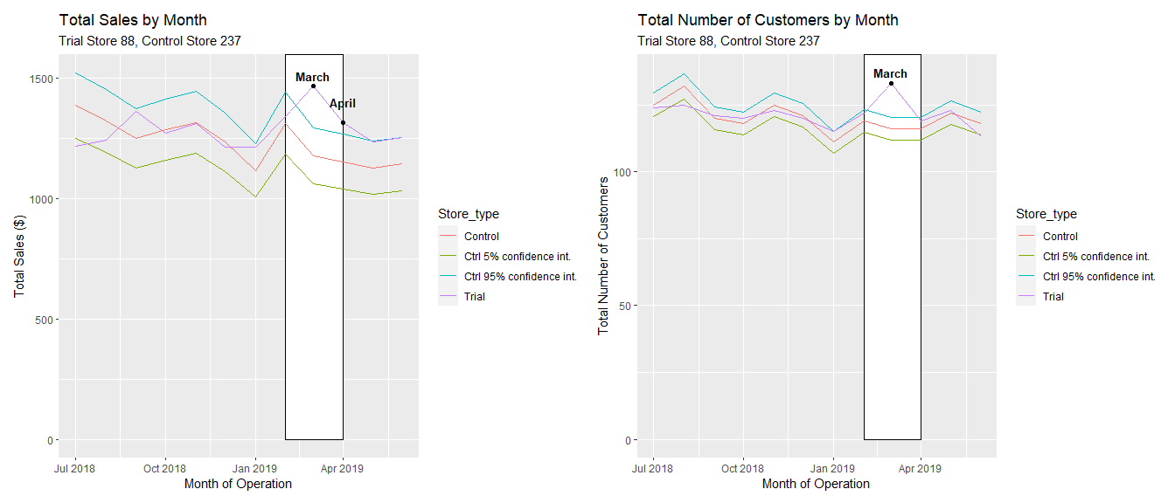
Store 88: Significant increase in March & April sales, but number of customers not significantly higher

Slide 27
Final Insights
Christmas is an ideal time to increase stock and promotion for Twisties, Thins, and 200g+ pack sizes, and to maintain stock of best-selling brands
Young singles/couples with mainstream affluence are an ideal target demographic, preferring Tyrells and Twisties more than other demographics.
The trial layout was successful in store 77, but only partially successful in store 86, 88. If the implementation of the trial layout was different in 86, 88, then that could explain the discrepancy.
All trial stores saw improvements to sales and number of customers in March. It’s possible that this is due to customer trends outside of the trial store layout changes.

